Slide 1
Gender Pay Gap Report
as at 31 March 2018

Slide 2

Gender pay gap report - our values
Working with local health, care and other partners, we aim to create an integrated network of sustainable services to achieve the best possible outcomes for local people’s health - based around the needs of individuals.
First Community Health and Care delivers front-line NHS services, providing first-rate care, through our first-rate people, offering first-rate value to our local community. We offer a friendly face with highly-rated, well run services, delivered by our skilled people. We provide community and specialist rehabilitation therapies and nursing, therapies and nursing in clinics, and children and family health care services. At Caterham Dene Hospital we have a minor injuries walk in clinic, rapid assessment/treatment clinic and we provide bed-based care.
Our vision Rejuvenating the wellbeing of our communities.
Our values
First-rate care
We are trained and knowledgeable professionals committed to providing seamless high quality, timely and safe care without boundaries. We are empathetic to the needs of service users, their families and carers, celebrating patient choice.
First-rate value
We are efficient and effective in our business, continually learning and improving, and are intellectually curious. We deliver value for money, bespoke care, focused on the health of the service user. We offer value back into the community, leaving a social impact locally.
First-rate people
We are caring, conscientious, compassionate and approachable people, supported to develop our potential. We are respectful and listen to understand what is important to others, and are effective at communicating with confidence and authenticity. We are flexible and adaptable to our community understanding their requirements of health care services.

Slide 3
Reporting Requirements
From April 2017 onwards, any UK organisation employing 250 or more employees is required to report publicly on its gender pay in six different ways:
1. Mean gender pay gap – ordinary pay
2. Median gender pay gap – ordinary pay
3. Mean gender pay gap – bonus pay in the 12 months ending 31 March
4. Median gender pay gap – bonus pay in the 12 months ending 31 March
5. The proportion of male and female employees paid a bonus in the 12 months ending 31 March
6. The proportion of male and female employees in each quartile
The gender pay gap shows the difference in the average earnings between all male and female employees within First Community.
The mean gender pay gap is the difference between the average hourly earnings of men and women. The mean (average) gender pay gap is the difference between the mean hourly rate of pay of male full-pay relevant employees and that of female full-pay relevant employees.
The median pay gap is the difference between the midpoints in the ranges of hourly earnings of men and women. The median (middle) gender pay gap is the difference between the median hourly rate of pay for male full-pay relevant employees and that of female full-pay relevant employees.

Slide 4
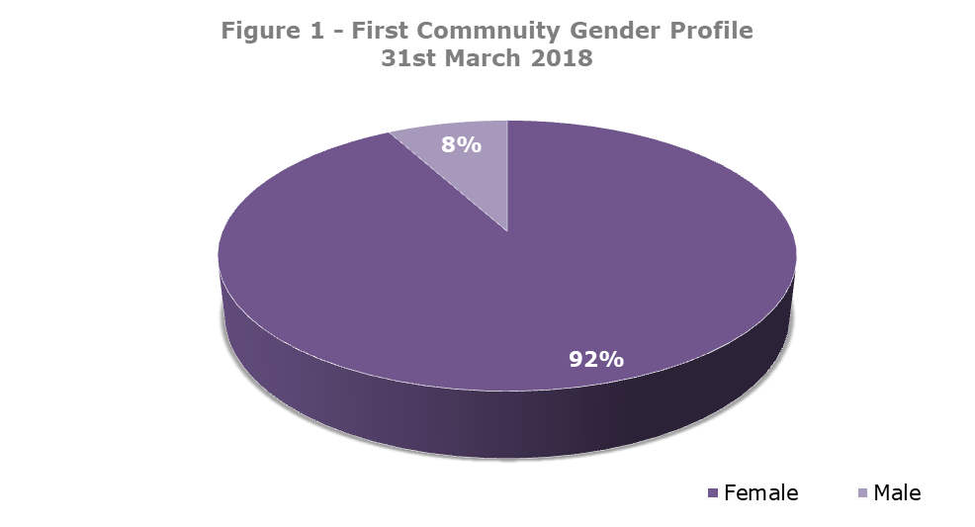
Our gender profile
Snapshot date – 31 March 2018
Figure 1 details our gender profile which is broadly the same as last year, with just 1% point increase of male employees. Of our the relevant employees, our workforce consisted of 407 female and 35 male members of staff.

Slide 5
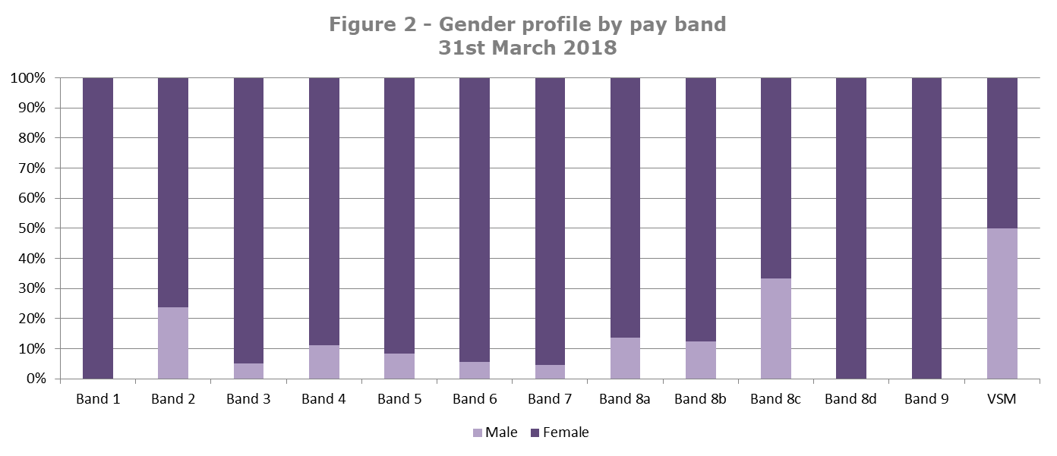
Gender profile by band
Pay structure
All First Community staff, except for the Chief Executive Officer and Director of Finance are paid on the National Agenda for Change (AfC) pay, terms and conditions system. The terms and conditions set out band structures and pay for all employees to ensure transparency, fairness and equal treatment for all.
Profile across bands
Figure 2 shows the profile across all bands. It should be noted that band 1 and 9 is reflective of one employee. Similarly pay band 8d and VSM includes just 2 employees.

Slide 6
Our gender pay gap data
First Community has a mean gender pay gap of 3.2% and a median gender pay gap of -1.7%. This is a positive reduction in our mean gender pay gap of more than 50% from last year’s figure of 6.5%. This could be attributed to a slight decrease in the female makeup of the lower quartile.
Recruitment Activity
Although a single activity will not be the only area to impact our gender pay figures, over the 12 month reporting period, the proportion of male senior appointments (band 8 and above) within First Community was 50% compared to female appointments. For appointments at band 8 and above there were 4 females appointed compared to 2 male.
*With regards to bonus pay, there were no employees who received a bonus pay in the 12 months ending 31 March, as a result the mean or median gender bonus pay gap is 0%.

Slide 7
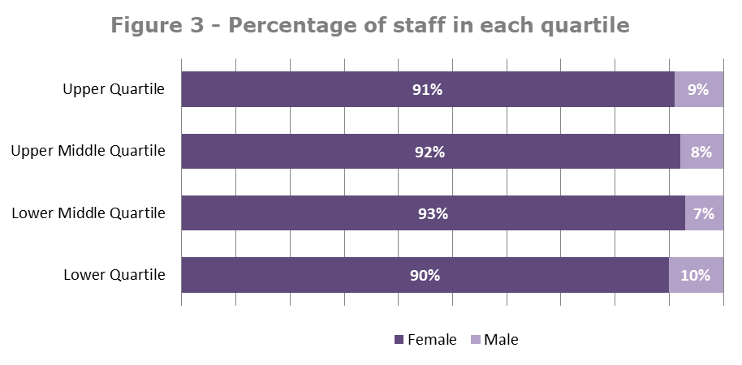
Our gender pay gap data
The information below details the number of staff and the percentage of staff within each salary quartile.
The percentage of staff within each of the quartiles have remained fairly consistent to 2017. There has been a slight increase in the percentage of male staff employed in the upper middle quartile. Each quartile is broadly representative of the workforce profile.

Slide 8
Our commitment
First Community is committed to continuing to be being a fair and equal employer. Ways in which we can continue to promote equality across the organisation includes:
  Encourage flexible working across our organisation at every level, to ensure that our employees have the opportunity to balance their home life and career aspirations.
  Continue to provide the leadership programme across all levels of staff, to equip managers with the essential insights, knowledge, and skills to directly improve job satisfaction and promote a happy workplace.
First Community has a robust recruitment process that has equality and diversity embedded into its processes. We will continue to recruit in a non-gender biased manner to ensure that adverts and applicants are recruited in a fair, open and transparent way.

